Slide 1

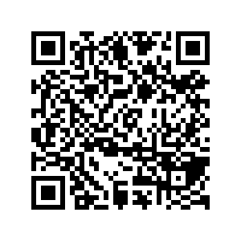
CS1010: Programming Methodology
UNIT 27
N Queens
Live Q&A
https://pollev.com/jin

Slide 2
Unit 27: N Queens
N Queens

Slide 3
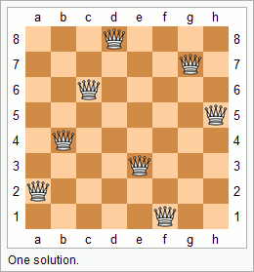
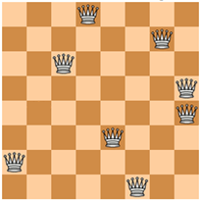


N Queens
Problem: Given a n x n chessboard, find a possible placement of n queens on the chessboard, such that the queens do not threaten each other
Examples:

Slide 4
N Queens
Problem: Given a n x n chessboard, find a possible placement of n queens on the chessboard, such that the queens do not threaten each other
Analysis
A placement is a sequence of positions for n rows
{'d', 'g', 'c', 'h', 'b', 'e', 'a', 'f'}
There cannot be repeated positions since two queens cannot be in the same column.

Slide 5
N Queens
Problem: Given a n x n chessboard, find a possible placement of n queens on the chessboard, such that the queens do not threaten each other
Recursive Thinking
What if we generate all permutations of the placements (recursively) and check whether it works?

Slide 6
N Queens
Implementation:
O(n!)
void nqueens(char queens[], long n, long row) {
if (row == n-1) {
if (!threaten_each_other_diagonally(queens, n)) {
cs1010_println_string(queens);
}
return;
}
nqueens(queens, n, row + 1);
for (long i = row + 1; i < n; i++) {
swap(queens, row, i);
nqueens(queens, n, row + 1);
swap(queens, row, i);
}
}

Slide 7
N Queens
Problem: Given a n x n chessboard, find a possible placement of n queens on the chessboard, such that the queens do not threaten each other
Improvement
Observation: Any placement starting with {'a', 'b', …} cannot work since the first two queens already threaten each other.
Permutate further only if the existing positions of the placement does not fail the check.

Slide 8
N Queens
Implementation:
void nqueens(char queens[], long n, long row) {
…
if (!threaten_each_other_diagonally(queens, row)) {
nqueens(queens, n, row + 1);
}
for (long i = row + 1; i < n; i++) {
swap(queens, row, i);
if (!threaten_each_other_diagonally(queens, row)) {
nqueens(queens, n, row + 1);
}
swap(queens, row, i);
}
}

Slide 9
Homework
Post-Lecture Diagnostic Quiz and Assignment 7
Due on Monday of Week 12, 4pm (extended due to public holiday)
Problem Set 25-27
To be discussed in Week 12 during tutorials.
PE2
Check out the general information / past year questions and start your preparation!

